Slide 1

Recurrent Neural Networks Long-Term Short-Term Memory
Women in AI Academy and Consultancy
Nabanita Roy

Slide 2
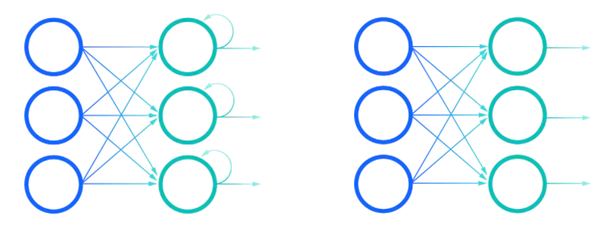

Recurrent Neural Networks
Applications:
Sequence Generation
Regression Problems
Image Caption
Generating poems
Generating Music
RNN Feed Forward

Slide 3
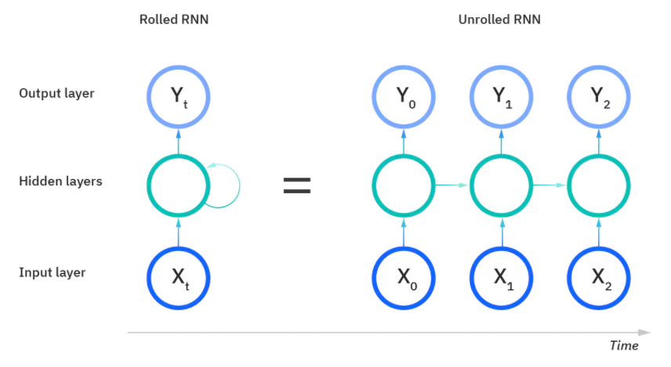
Recurrent Neural Networks
Drawback:
Vanishing Gradient
~ Has short term memory

Slide 4
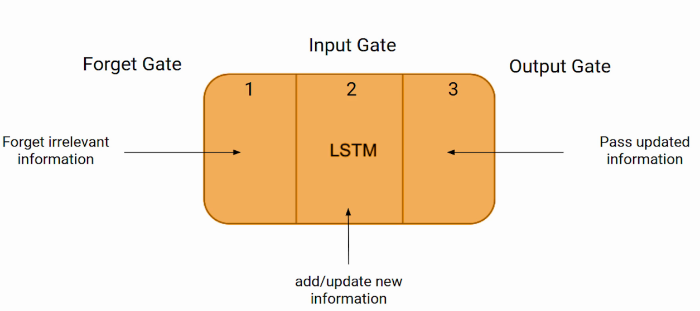
Long-Term Short-Term Memory (LSTM)
Stores the meaningful words in its memory

